Slide 1
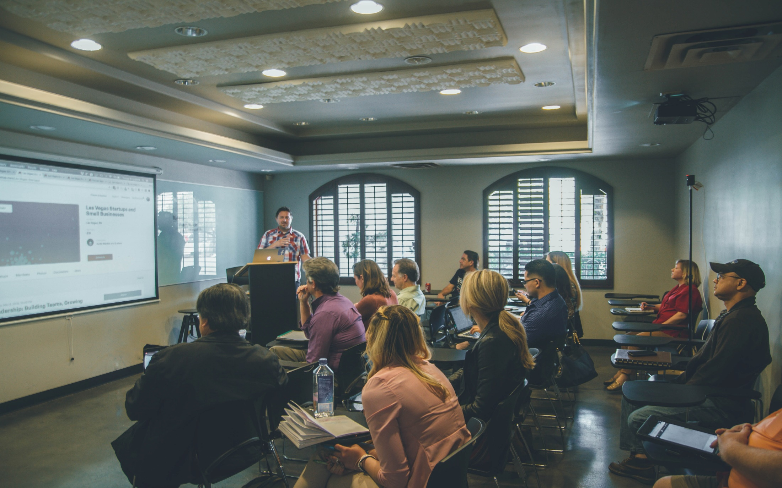
Microsoft Engage ‘22
Face Recognition
Developing a Web Based Application using Face Recognition for Attendance Management System

Slide 2

Attendance Management
An Attendance Management System uses Face Recognition to precisely track attendance, breaks, time off taken, clock in and clock out of an employee.
With rapid modernization and development in technology, face recognition is being used in various fields to automate and make things simpler.

Slide 3
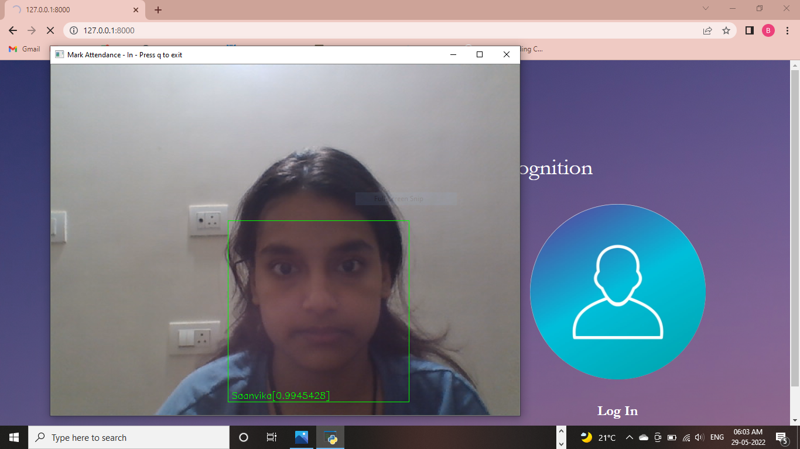
Face Recognition
The Attendance Management System uses Python Libraries such as Dlib and Face_Recognition to detect face. It also uses Dlib's 68 point shape predictor to detect facial landmarks for higher accuracy.

Slide 4
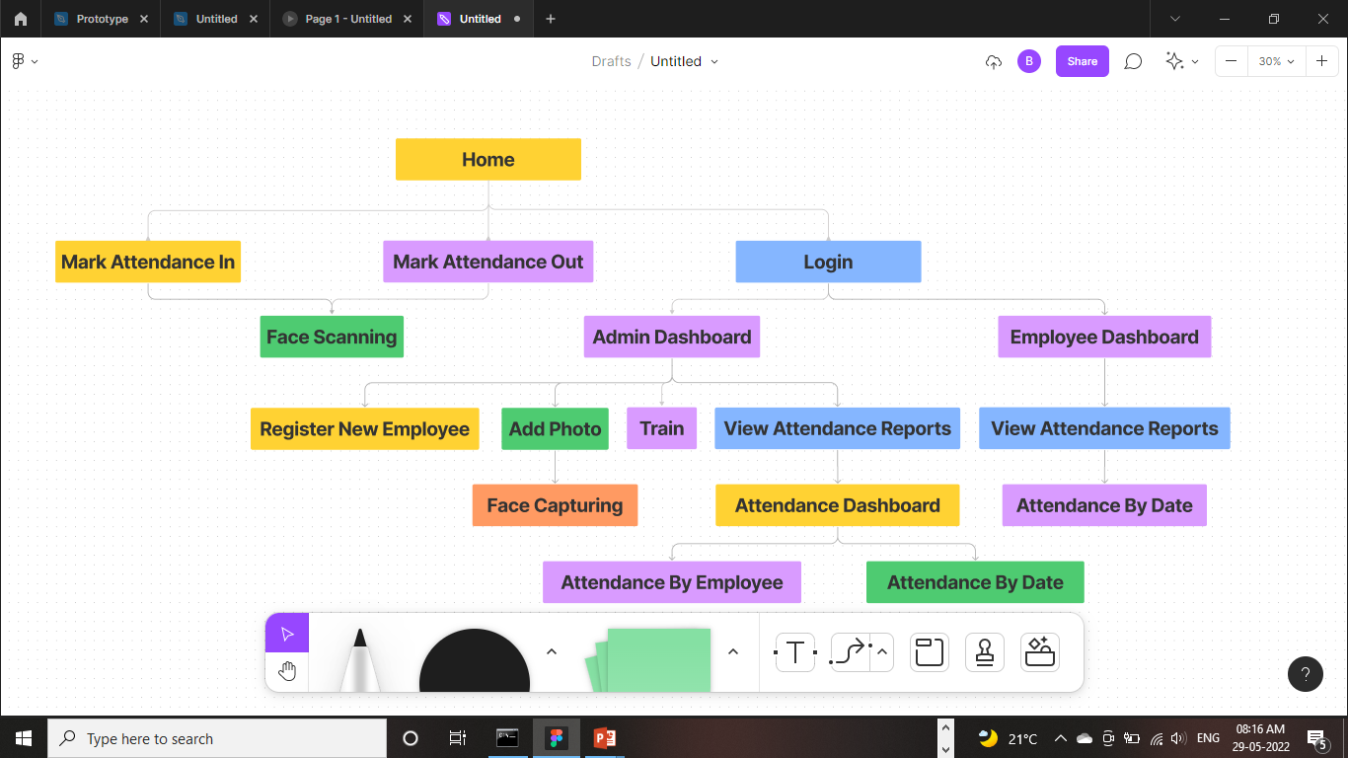
Flowchart

Slide 5

Thank You!!
Presented By-
Saanvika Bajaj

